Slide 1
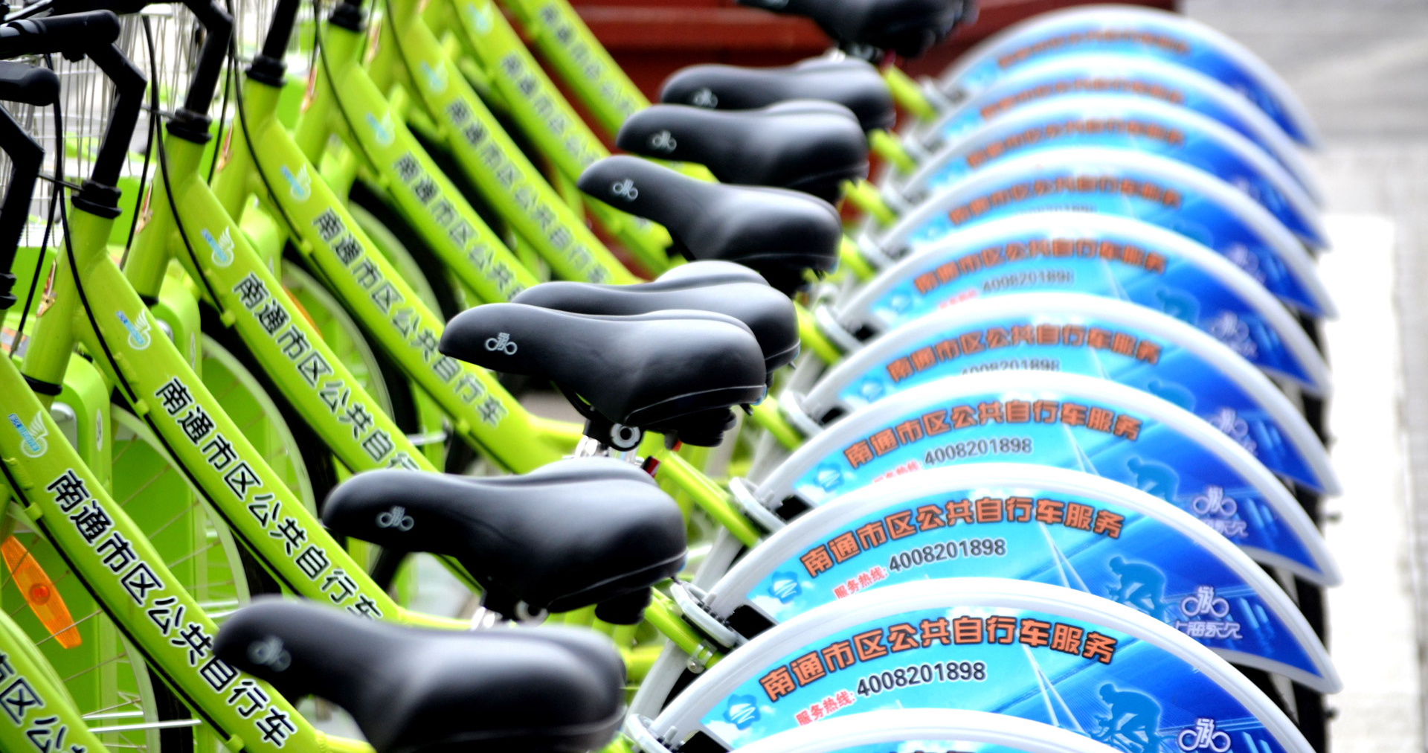
Seoul Bike Rental

Slide 2

Introduction
Rental bikes are introduced in many urban cities for the enhancement of mobility comfort. It is important to make the rental bike available and accessible to the public at the right time as it lessens the waiting time. Eventually, providing the city with a stable supply of rental bikes becomes a major concern.
The crucial part is the prediction of bike count required at each hour for the stable supply of rental bikes.
Attribute Information: Date , Rented Bike count , Hour, Temperature, Humidity, Windspeed, Visibility , Dew point temperature , Solar radiation , Rainfall , Snowfall, Seasons, Holiday, Functional Day
Columns are: 8760

Slide 3
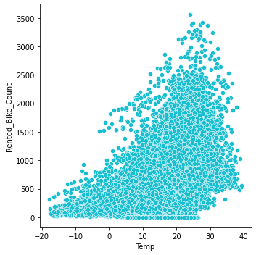
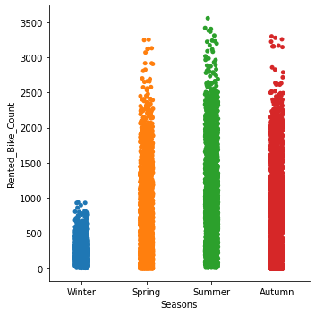
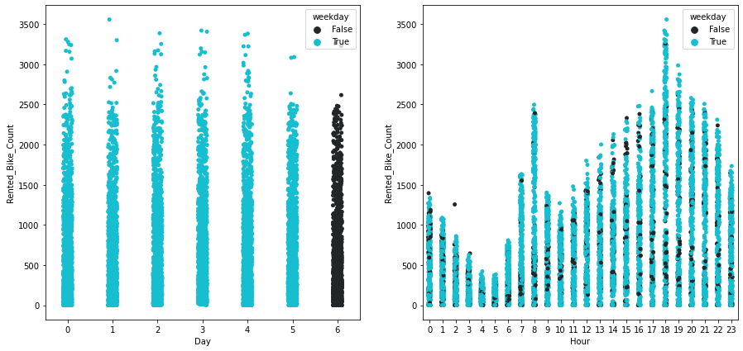
Data Visualization
From the first plot we can see the increase in the bike rental warmer temperatures, the second plot increase in bike rental spring and summer, the third and froth plot we can see that weekdays have the most rentals, and from the froth plot we can see which hours are the most has the most rentals.

Slide 4

Regression models
Support Vector Regression
Linear Regression
Random Forest Regressor
Kernel Ridge Regression
Gradient Boosting Regression
Elastic Net Regression

Slide 5
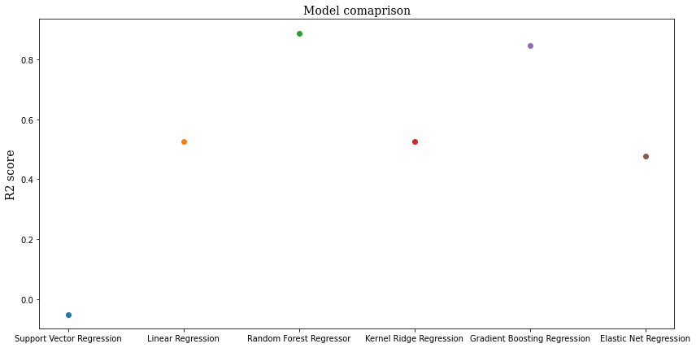
Cross validation
From the plot we can see that the Random Forest Regression is the best
Support Vector Regression -0.050729514232273856
Linear Regression 0.5265896963825203
Random Forest Regressor 0.8876007741761542
Kernel Ridge Regression 0.5266297025107167
Gradient Boosting Regression 0.8459279014746149
Elastic Net Regression 0.47641377243987887

Slide 6
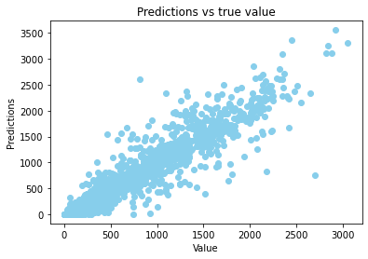

Slide 7

Thank you!
Hanin Falatah

